Slide 1

Neural Substrates of Attention and Awareness
Dan Birman
Gardner Lab
Frisem – 2015-04-17

Slide 4


Slide 5


Slide 8
Neural Substrates of Attention and Awareness
Dan Birman
Gardner Lab
Frisem – 2015-04-17

Slide 11


Slide 12


Slide 13
Attention as a Pre-Requisite to Awareness
Dual task designs “pull” attention to one task, causing inattentional blindness for other stimuli.

Slide 14
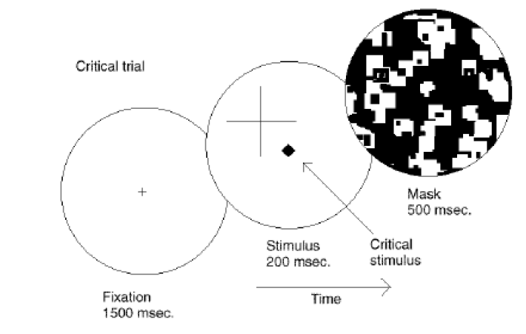
Attention as a Pre-Requisite to Awareness
Dual task designs “pull” attention to one task, causing inattentional blindness for other stimuli.
Mack & Rock, 1998
Notes:
There is one situation where attention (seems) to not be a pre-requisite for awareness

Slide 15
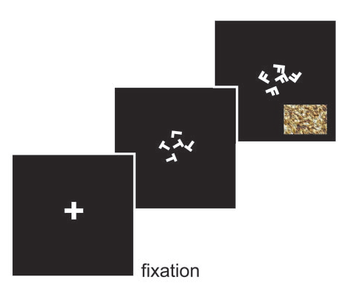
Gist Perception
Li et al., 2002

Slide 16
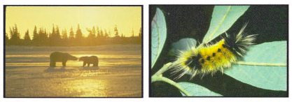
Gist Perception
Li et al., 2002

Slide 17
Gist Perception vs. Inattentional Blindness
“we believe […] there is no conscious perception without attention” (Mack & Rock, 1998)
“The close relationship between attention and
consciousness has led many scholars to conflate these processes“ (Koch & Tsuchiya, 2006)

Slide 18
A Possible Explanation
The distinction between attention and awareness is not conceptual: these are neural processes.
A biologically grounded theory should explain both of these phenomena.

Slide 19
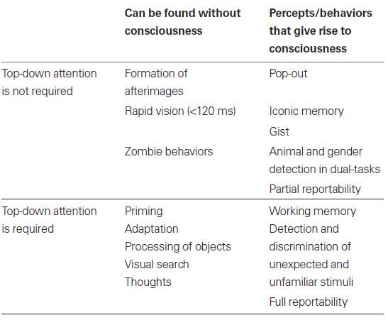
P
Perception of Stimulus:
Unaware
Aware
Unattended
Stimulus Is:
A
Attended

Slide 20
P
Perception of Stimulus:
Unaware
Aware
Unattended
Gist Perception
Stimulus Is:
A
Attended

Slide 21
P
Perception of Stimulus:
Unaware
Aware
Unattended
Inattentional
Blindness
Gist Perception
Stimulus Is:
A
Attended

Slide 22
P
Perception of Stimulus:
Unaware
Aware
Unattended
Inattentional
Blindness
Gist Perception
Stimulus Is:
A
Attended
Normal Vision

Slide 23
P
Perception of Stimulus:
Unaware
Aware
Unattended
Inattentional
Blindness
Gist Perception
Stimulus Is:
A
Attended
Continuous Flash
Suppression
Normal Vision

Slide 24
P
Perception of Stimulus:
Unaware
Aware
Unattended
Inattentional
Blindness
Gist Perception
Stimulus Is:
A
Attended
Normal Vision

Slide 25
P
Perception of Stimulus:
Unaware
Aware
Unattended
Inattentional
Blindness
Gist Perception
Stimulus Is:
A
Attended
Normal Vision
Trajectory Depends on
Interaction Between
Stimuli

Slide 26
Response: Which side is higher?

Slide 27
Response: Which side is more coherent?

Slide 28
Response Cued: 85%
Attend to Contrast
Respond about Contrast
Response Uncued: 15%
Attend to Contrast
Response about Motion Coherence

Slide 29
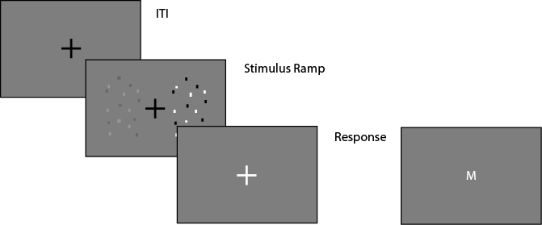
Task Design
Fixation: .4 - .8 s
Fixation
Stimulus Ramp: 1.4 s
Fixation
Response: 1.2 s (cued) / 3 s (catch)
Fixation

Slide 30
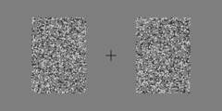
Task Design
Fixation
Stimulus Ramp: 1.4 s
Fixation
Response: 1.2 s (cued) / 3 s (catch)
Fixation

Slide 31
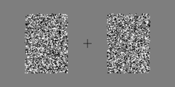
Task Design
Fixation
Stimulus Ramp: 1.4 s
Fixation
Response: 1.2 s (cued) / 3 s (catch)
Fixation

Slide 32
P
Perception of Stimulus:
Unaware
Aware
Unattended
Stimulus Is:
A
Attended

Slide 33
P
Perception of Stimulus:
Unaware
Aware
Response Uncued:
Coherence
(Unattended)
Stimulus Is:
A
Response Cued:
Contrast
(Attended)

Slide 34
P
Perception of Stimulus:
Perceptually Identical:
(Unaware)
Perceptually Distinct:
(Aware)
Response Uncued:
Coherence
(Unattended)
Stimulus Is:
A
Response Cued:
Contrast
(Attended)

Slide 35
P
Perception of Stimulus:
Perceptually Identical:
(Unaware)
Perceptually Distinct:
(Aware)
Response Uncued:
Coherence
(Unattended)
Stimulus Is:
A
Response Cued:
Contrast
(Attended)

Slide 36
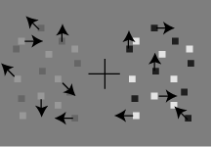
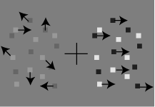
P
Perception of Stimulus:
Perceptually Identical:
(Unaware)
Perceptually Distinct:
(Aware)
Response Uncued:
Coherence
(Unattended)
Stimulus Is:
A
Response Cued:
Contrast
(Attended)

Slide 37
Discrimination of Contrast
Attend to
Contrast
Effect On
Discrimination of Motion
Coherence

Slide 38

Mack & Rock
Attention is
Required for Awareness
Discrimination of Contrast
Attend to
Contrast
Effect On
Discrimination of Motion
Coherence

Slide 39

Mack & Rock
Attention is
Required for Awareness
Discrimination of Contrast
Attend to
Contrast
Effect On
Discrimination of Motion
Coherence
Attention and
Awareness are Distinct
Koch & Tsuchiya

Slide 40
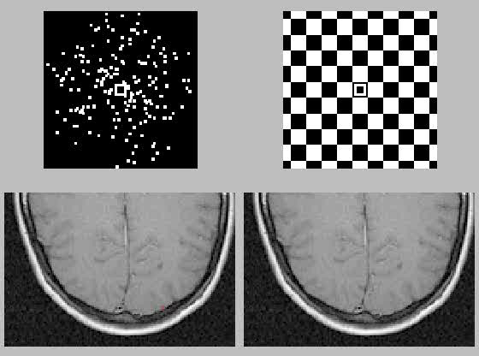
http://www.cns.nyu.edu/~david/courses/perception/lecturenotes/motion/motion.html

Slide 41
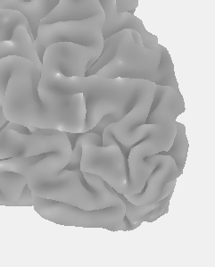
Attend to:
Contrast
Coherence
Discrimination of Contrast
Effect On
Discrimination of Motion
Coherence
Sensory Enhancement
of Contrast may
Feed Forward to MT
MT
V1
Lateral View: LH

Slide 42
Sensory Enhancement
of Coherence is unlikely
to Feed Back to V1
Attend to:
Contrast
Coherence
Discrimination of Contrast
Effect On
Discrimination of Motion
Coherence
MT
V1
Lateral View: LH

Slide 43
Mack & Rock
Cued to:
Contrast
Coherence
Coherence
Contrast
Effect on:

Slide 44
Mack & Rock
Cued to:
Contrast
Coherence
Coherence
Contrast
Can Discriminate?

Slide 45
Mack & Rock
Cued to:
Contrast
Coherence
Coherence
Contrast
Can Discriminate?
Koch & Tsuchiya
Contrast
Coherence
Coherence
Contrast

Slide 46
Mack & Rock
Cued to:
Contrast
Coherence
Coherence
Contrast
Can Discriminate?
Koch & Tsuchiya
Contrast
Coherence
Coherence
Contrast
Neural Substrates Hypothesis
Contrast
Coherence
Coherence
Contrast

Slide 47
How does discrimination
map onto Awareness?

Slide 48
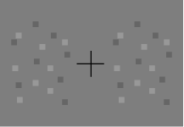
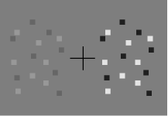
A Proxy for Awareness

Slide 49
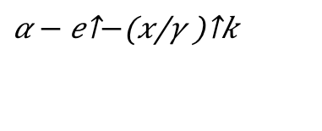
A Proxy for Awareness
Maximum Likelihood Fit:
Weibull Function
$$α − e^{−{\left(\frac{x}{γ}\right)}^{k}}$$

Slide 50
A Proxy for Awareness
Maximum Likelihood Fit:
Weibull Function
$$α − e^{−{\left(\frac{x}{γ}\right)}^{k}}$$

Slide 51
A Proxy for Awareness

Slide 52
A Proxy for Awareness

Slide 53
A Proxy for Awareness
Easier: Less Difference
Same Performance

Slide 54
A Proxy for Awareness
Easier: Less Difference
Same Performance
What is the effect of cueing?

Slide 55
Effect of Attention

Slide 56
Effect of Attention

Slide 57
Strength
Strength

Slide 59
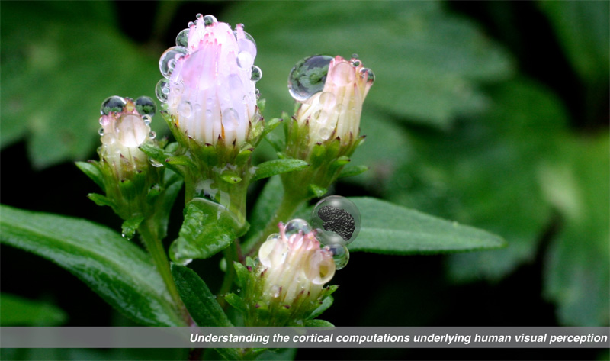

Gardner Lab @ Stanford University
Thank You!
Justin Gardner
Steeve Laquitaine
1st Year Cohort

Slide 60
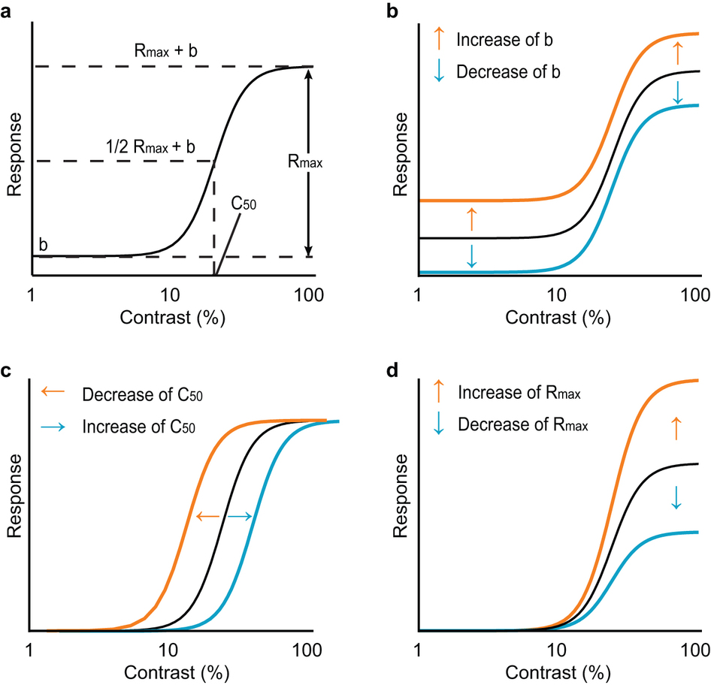
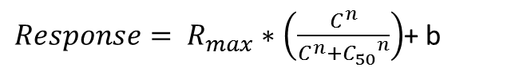
$Response= R_{max}∗\left(\frac{C^{n}}{C^{n}+{C_{50}}^{n}}\right)$+ b
Baseline Shift
Response Gain
Contrast Gain
Soma et al. 2013

Slide 61
Behavior in the Scanner
Outside
Inside Scanner

